Slide 1

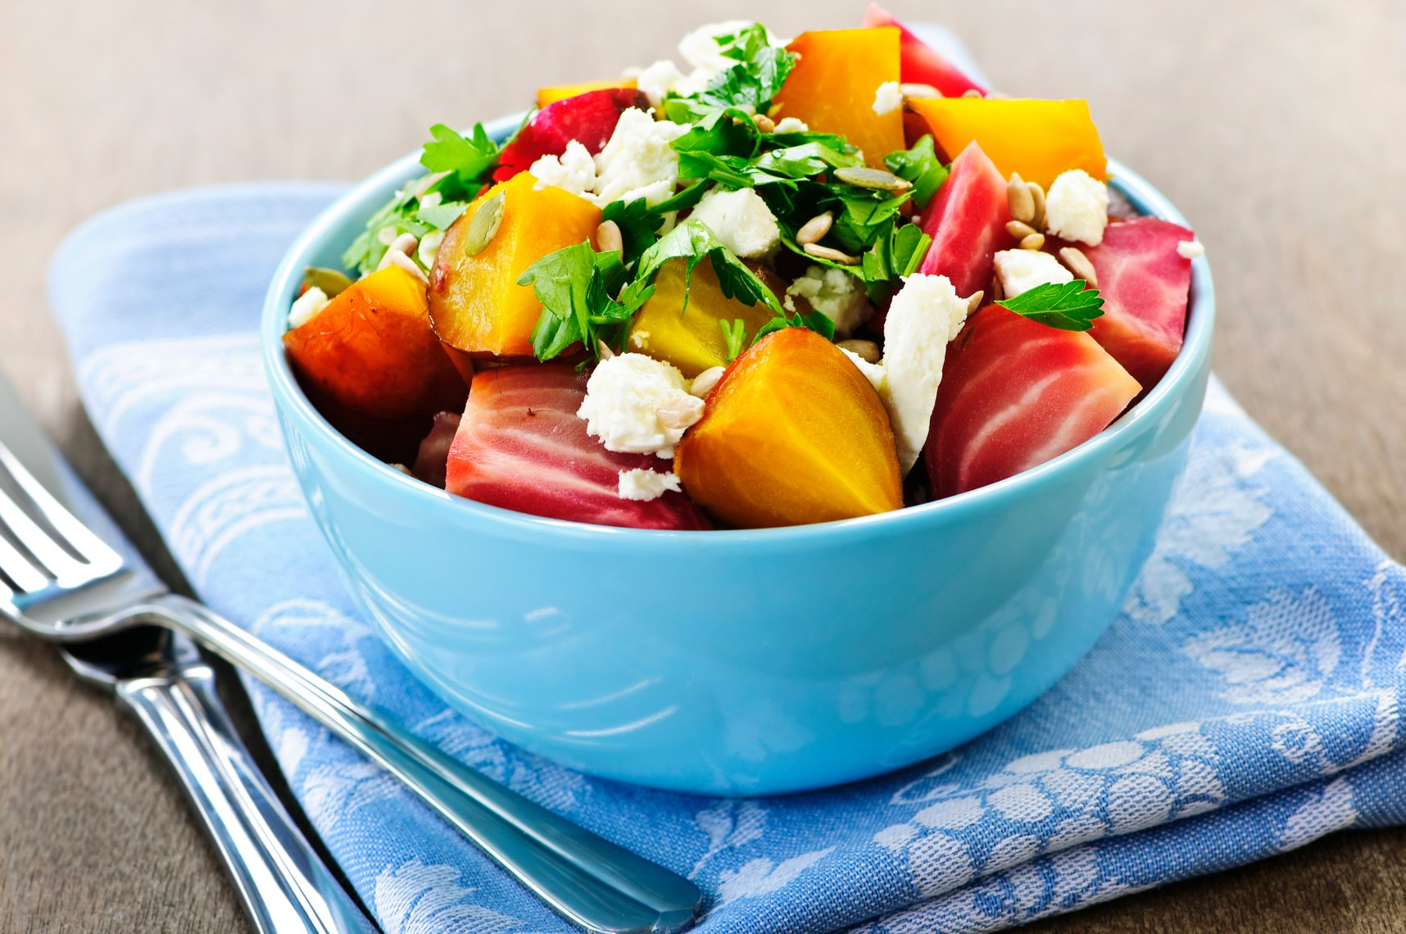


COOK
FRESH
WE GROW AND DELIVER ORGANIC FOOD.

Slide 2

PROBLEM STATEMENT
Customers have been facing long trust issues on the food production companies about the healthy, quality, fresh, and nutritional food as they are unaware of the origin of the food products.
High dependency on other food production companies for growing fruits and vegetables
COOK FRESH

Slide 3

WHO ARE THE USERS?
End Users
General public
Super marches
Local vendors
Food production companies
COOK FRESH

Slide 4

DEFINING THE NEED
What does the customer need?
Hygienic food
Nutritious food
Quality products
Trust in food quality
COOK FRESH

Slide 5
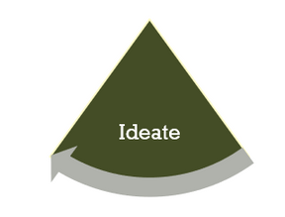
IDEATING THE SOLUTION
With the days passing by, we developed our idea of growing food at Greenhouse farmlands in an organic and sustainable way.
We have developed our food production business and thus came up with the very cool idea of selling the Food Baskets, Meal-kits.
COOK FRESH

Slide 6

WHAT IS OUR MAIN PROJECT? ORGANIC GREENHOUSE AND PRODUCTION WAREHOUSE
We had this revolutionary plan of growing food in an organic greenhouse to support the production warehouse.
By laying the foundations on our vision and objectives we created an advanced and modern Organic Greenhouse and Production Warehouse in the heart of Montreal.
We funded the Greenhouse (renting the space) with the support of the Government and recreating the existing industry space with the support of local Farmers.
Our main goal is to grow and sell organic and sustainable products.
COOK FRESH

Slide 7







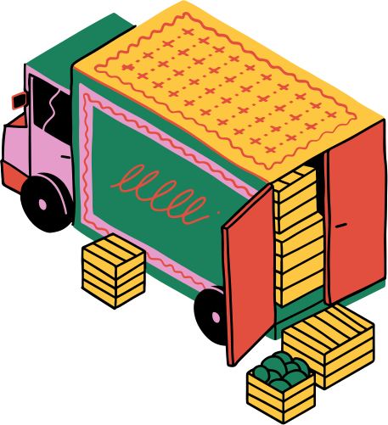






PROTOTYPING
FARMING FACILITY
PRODUCTION
INVENTORY
SHIPPING
TECH TEAM
FRONT DESK
EMPLOYEE REST AREA
CAFE

Slide 8
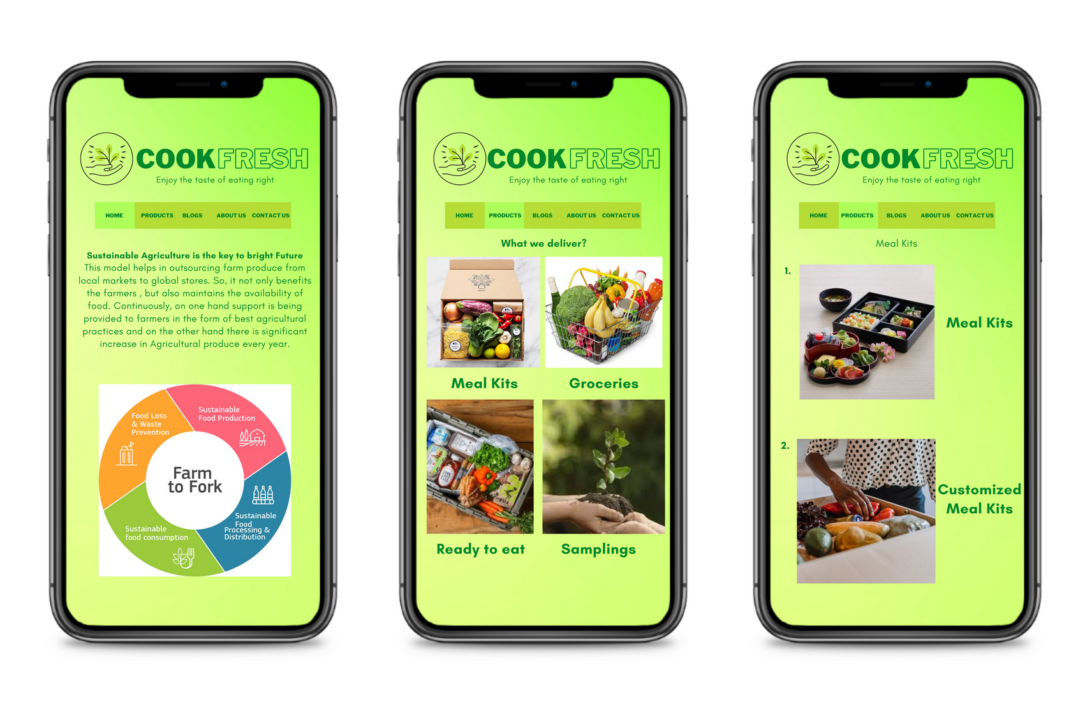

Slide 9
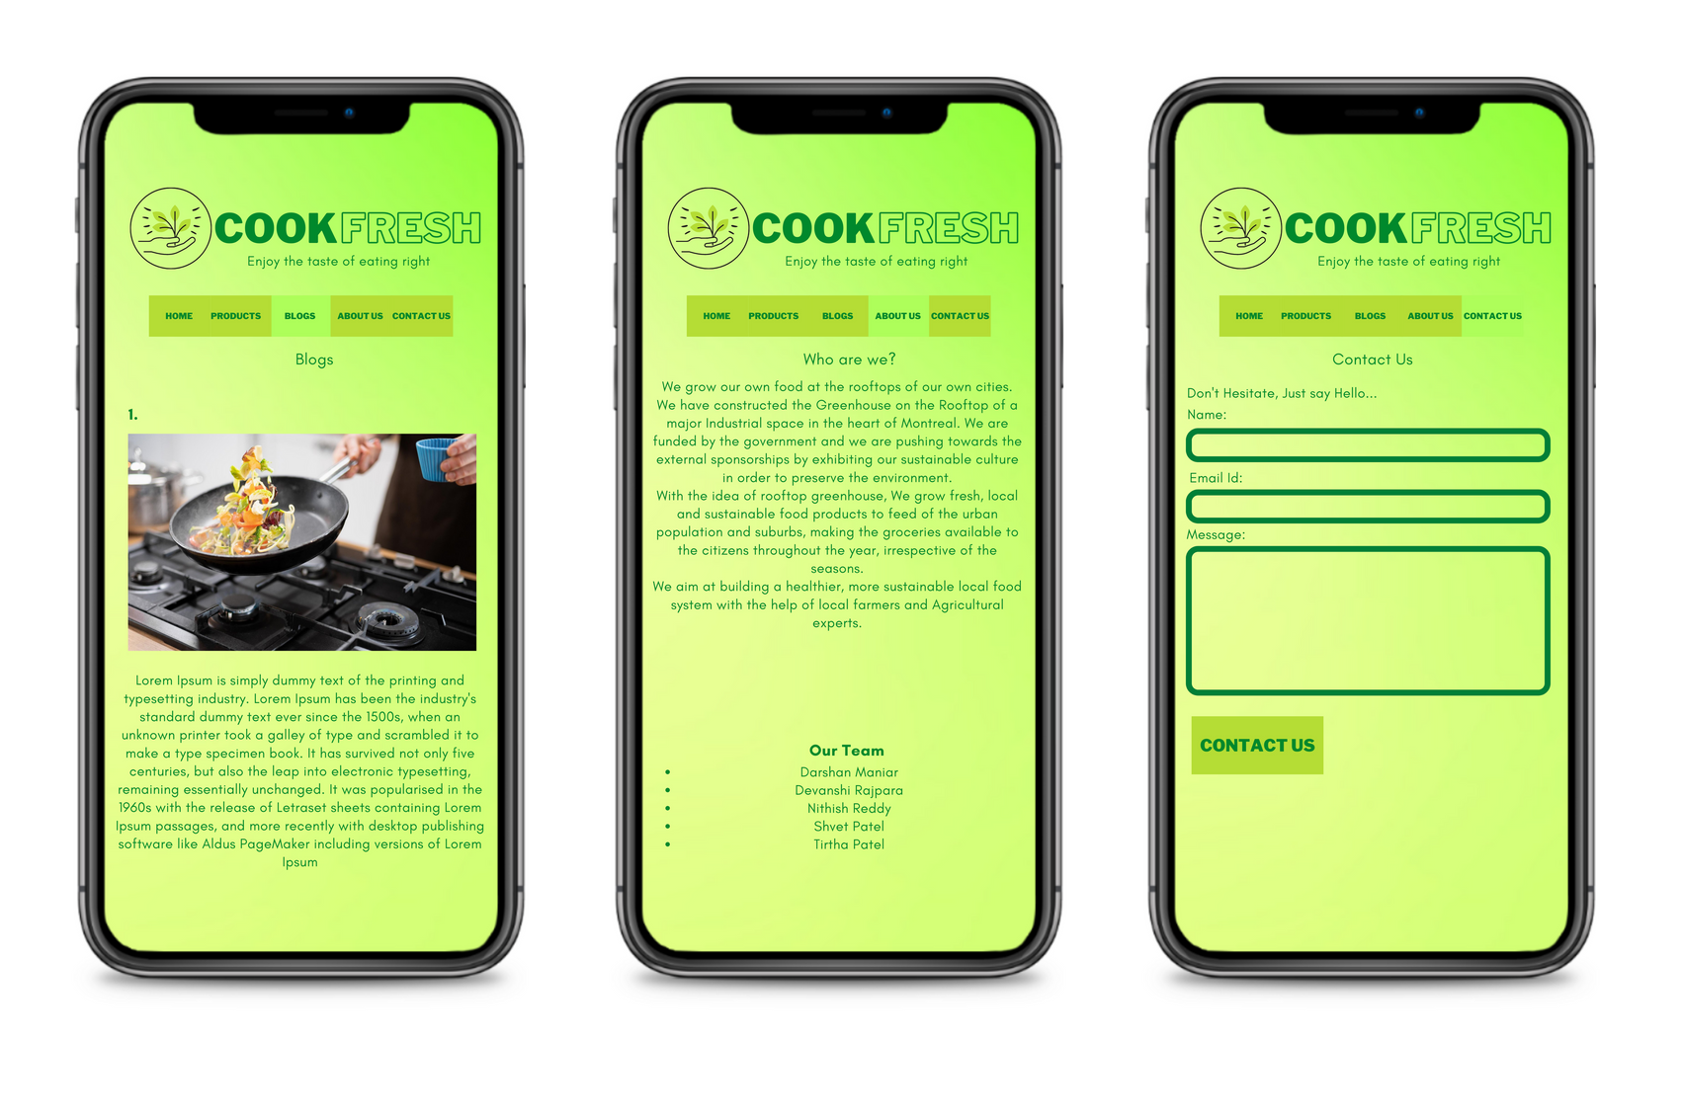

Slide 10

Interview
How reliable are your ingredients suppliers? Have you ever faced any delay because of them?
Ingredient suppliers are fundamental to our day-to-day operations as we are very much dependent on them to ensure your delivery of our Products.
Over the months, we have faced several issues on the quality as well as the timely delivery of the ingredients.
How do you ensure the freshness of the food that you pack?
The complete production facility is supervised and kept in the temperature range of 0° - 4°C according to the candian Health Agencies.
What is the Workforce of your facility?
Goodfood operates on a shift basis. AM, PM, and Night Shift. Each shift operates with close to 150 members including Supervisors, Coordinators and QA's
What do you think you can improve in your facility?
It would be very encouraging to our very own farming facility to overcome the quality and delivery issues. Also, we were planning to integrate the current supply chain with ERP.
Name:
Christy Jasper
Occupation:
Production Manager
Organization:
Organization:
GoodfoodMarket Coorp

Slide 11
FOOD BASKETS
SAMPLINGS
Doorstep delivery of these food baskets. The only thing you'll have to do is buy the products you wish, and we deliver
You can buy the organic samplings which we grow in our farming facility.
Our Products
MEAL-KITS
Eat healthy and nutritional food by ordering the meal-kits and delivery is within 1 day. You can always adjust your spices and we send you that
GROCERIES
Buy fruits and vegetables and our certified food products
Cook fresh

Slide 12

STAKEHOLDERS
Warehouse Maintainance
Warehouse Workers
Logistics and Transportation
Greenhouse Maintanence
Greenhouse Workers
Employees
Tech and Reception
Food Delivery
COOK
FRESH
General Public
Food Inspection
Food Production Agencies
Quality Assurance
Plant Science Experts
Customers
Local Super Marche's
Automation
COOK FRESH

Slide 13
THE SITUATION
4,200
10,000
We are currently at 4.2k customers per week, which is above the initial goal of 3,500 customers per week.
We have set up a new target to provide services and products to 10,000 customers, which deliver our next realistic achievement.
COOK FRESH

Slide 14
OUR 2022 GOAL
To reach a 100% increase in our number of customers per week.
80
60
40
20
0
Jan
Feb
Mar
Apr
May
Jun
Jul
Aug
Sep
Oct
Nov
Dec
COOK FRESH

Slide 15

DEMOGRAPHICS OF CURRENT CUSTOMERS
Male and female customers,
18 - 60 years old
01
Mostly employed, only 10% are undergrad or unemployed
02
Lives or works within the 50-mile radius of our Greenhouse
03
COOK FRESH

Slide 16
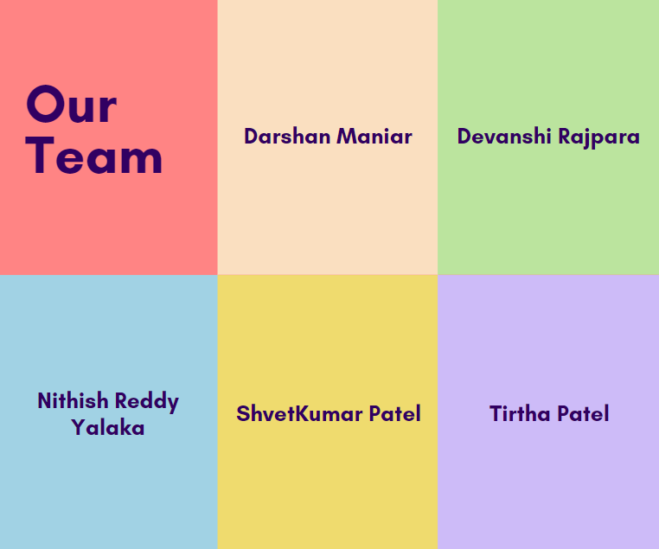

Slide 17
COOK
FRESH
THANK YOU!

